Slide 1
FUNCTION OVERLOADING

Slide 2
Function 1:
void sum( );
Function 2:
void sum( int);

Slide 3
When several function declaration are specified for a single function name in the same program , the function name is said to be overloaded.
C++ allows functions to have the same name, they are distinguished by their number or type of arguments.

Slide 4
Function overloading
A function name having several definitions that are differentiable by the number or types of their arguments is known as function overloading.

Slide 5
eg : void divide( int ); // F1
void divide( int, int); //F2
Function call
divide(10);
// will invoke F1
divide(12,13);
// will invoke F2

Slide 6
Need for function Overloading
Needed to reduce the number of comparisons in a program.
Function overloading implements polymorphism.
Polymorphism refers to ‘One name having different forms’
Ability of an object to behave differently in different circumstances.

Slide 7
Declaration and definition
A function argument list ( ie number and type of parameter ) is known as function signature.
The key to function overloading is function signature

Slide 8
If 2 functions have the same number and type of arguments in the same order, they are said to have the same signature. Even if they are using different variable it will not matter.
void square(int a, float b);
void square(int x, float y);

Slide 9
C++ allows you to overload the function name
To overload a function name, all you have to do is declare and define all the functions with the same name but different signatures.
For eg
void psqrt(int); // F1
void psqrt( char c); //F2
void psqrt(float); //F3
void psqrt(int, float); //F4

Slide 10
After declaring overloading function, you must define them separately
void psqrt(int a)
{ cout << a;}
void psqrt( char c)
{ c++ ; cout<<c; }
void psqrt(float x)
{ x=x/10; cout<<x;}
void psqrt(int x, float y)
{ cout<< x <<“ “<<y;}

Slide 11
Calling overloaded functions
Write the function call for
F1
F2
F3
F4

Slide 12
When a function name is declared more than once in the program, the compiler will determine the second declaration as follows:
If the signature of the second function matches the first function, then the second one is treated as the re-declaration of the first one.
If the signature of the two function match but the return type differ, the second is treated as error.

Slide 13
For eg:
float square( float f);
double square(float f); // error

Slide 14
Functions with the same signature and same name but different return types are not allowed in c++. Different return type is allowed only if argument list is different.
float square( float f);
int square( double x);
If the signatures of the two functions differ in either the number or type of their arguments, then the two functions are considered to be overloaded.

Slide 15
Restrictions on overloaded functions
Any 2 functions in set of overloaded functions must have different argument list.
Overloaded functions with same argument list, but different return type is an error
typedef declaration do not define new type, they only introduce synonyms for the existing types. They do not affect overloading.

Slide 16
POLYMORPHISM
Function overloading implements polymorphism in an Object oriented language.
That is the ability of an object to behave differently in different circumstances , which is implemented through function overloading.
Function overloading reduces number of comparisons in a program and thereby makes the program run faster.

Slide 17
STEPS INVOVLED IN FINDING THE EXACT MATCH
There are three possible cases, a function call may result in :
1. A match : A match is found in the function call.
2. No match : No match is found for the function call. Match can be found through promotion
ie conversion of char to int, int to float.
3. Ambiguous match : More than one function match

Slide 18
Search for an Exact Match
If the type of the actual argument exactly matches the type of one defined instance, the compiler invokes that particular instance. For example,
void fun(int);
void fun(double);
fun(0);
0 (zero) is of type int , thus the call exactly matches fun(int).
//overloaded functions
//exactly match. Matches afunc(int)

Slide 19
2. A match through promotion
If no exact match is found, an attempt is made to achieve a match through promotion of the actual argument.
Recall that the conversion of integer types (char, short int) into int (if all values of the type can be represented by int) or into unsigned int (if all values can’t be represented by int) is called integral promotion.

Slide 20
For example, consider the following code fragment:
void fun (int);
void fun (float);
fun (‘c’);
//match through the promotion; matches afunc (int)

Slide 21
3. A match through application of standard C++ conversion rules
If no exact match or match through a promotion is found, an attempt is made to achieve a match through a standard conversion of the actual argument. Consider the following example,
void fun (char);
void fun(double);
fun(471);
//match through standard conversion matches afunc (double)

Slide 22
The int argument 471 can be converted to a double value 471 using C++ standard conversion rules and thus the function call matches (through standard conversion) func(double).
But if the actual argument may be converted to multiple formal argument types, the compiler wil generate an error message as it will be ambiguous match. For example,
void fun (long);
void fun (double);
fun (15);
Here the int argument 15 can be converted either long or double, thereby creating an ambiguous situation as to which afunc() should be used.
//Error !! Ambiguous match

Slide 23
4. A match through application of a user-defined conversion.
If all the above mentioned steps fail, then the compiler will try the user-defined conversion in the combinations to find a unique match.
Any function, whether it is a class member or just an ordinary function can be overloaded in C++, provided it is required to work for distinct argument types, numbers and combinations.

Slide 24
Using default arguments
void amount( float price=1000, int time=2, float rate=0.08)
{ cout<< price<<time<<rate;}
Consider the following function call cases:
1. amount(2000) // price= ? , time = ?, rate =?
2. amount( 2500,3) // price= ? , time = ?, rate =?
3. amount( 2300,3,0.11) // price= ? , time = ?, rate =?
4. amount( 2300,0.11) // price= ? , time = ?, rate =?
5. amount( 5,0.11) // price= ? , time = ?, rate =?

Slide 25
Same program illustrated through Function overloading
void amount( float price, int time, float rate); // f1
void amount( float price, int time); // f2
void amount( float price, float rate); // f3
void amount( int time, float rate); // f4
void amount( float price); // f5

Slide 26
Consider the following function call cases:
1. amount(2000) // Which Function ?
2. amount( 2500,3) // Which Function ?
3. amount( 2300,3,0.11) // Which Function ?
4. amount( 2300,0.11) // Which Function ?
4. amount( 5,0.11) // Which Function ?

Slide 27
Advantages of Function overloading over default arguments
Default arguments might not work for all possible combinations of arguments whereas a function may be overloaded for all possible combination of arguments.
With function overloading, multiple function definitions can be executed but with default arguments exactly one function definition is executed.

Slide 28
iii. By declaring an overloaded function, you save the compiler from the trouble of pushing the default argument value on the function call stack .

Slide 29
Programs
Using function overloading write the program to find the area of circle , rectangle, triangle.
2. W.A.P that uses a function to check whether a given number is divisible by another number or not. However, if the second number is missing, the function should check whether the given number is prime or not ( USE FUNCTION OVERLOADING PROPERTY)

Slide 30
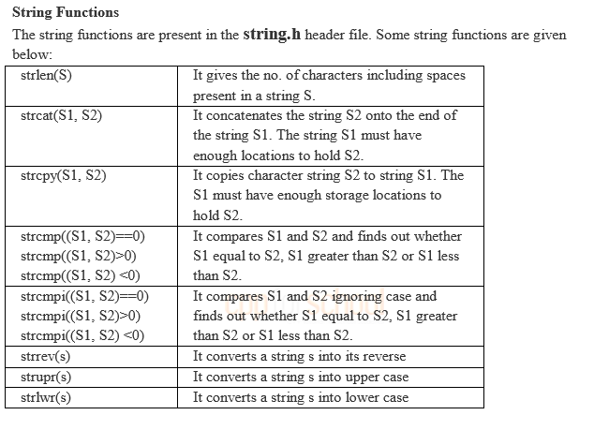

Slide 31
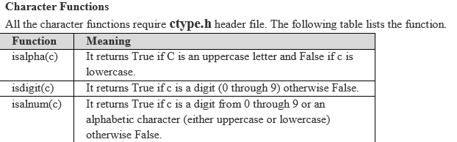


Slide 32
